Slide 1

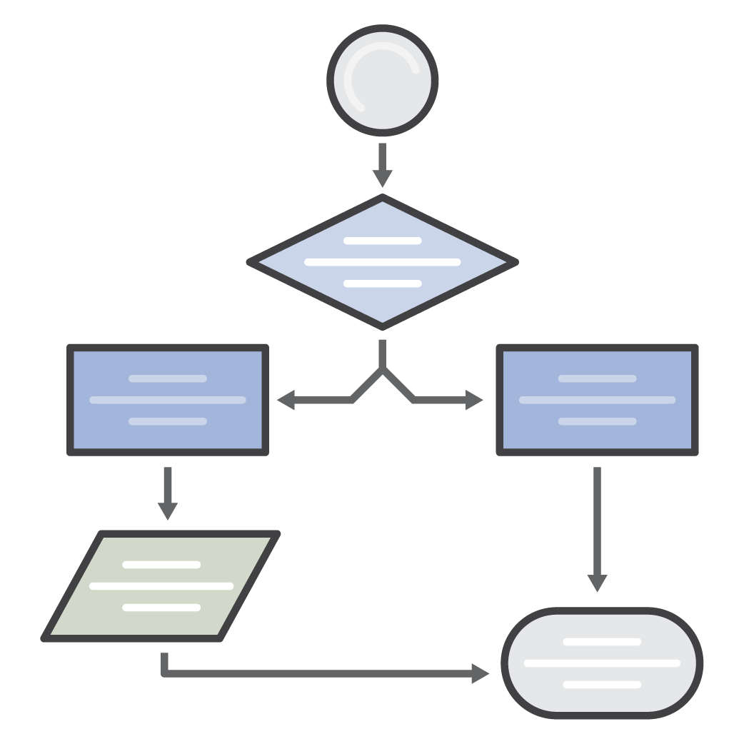



AWS Simple Icons
Check to make sure you have the most recent set of AWS Simple Icons
Find the most recent set at: aws.amazon.com/architecture/icons/
Always use icon labels
Be sure to always include a label below the icon or on the group in Arial. The only exception is in complex diagrams; you have the option to create a key.
Non-AWS technology
Any server or other non-AWS technology in an architecture diagram should be represented with the grey server (see Slide 29).
Creating diagrams
Try to use direct lines (rather than ‘criss-cross’), use adequate whitespace, and remember to label all icons.
Console icons
The first icon in most service sets is the console icon. These should be used to represent the service on a more general level when you will not be going into as much depth.
cluster
Amazon EC2
traditional server
AWS Simple Icons: Usage Guidelines

Slide 2
Table of Contents
Compute
4
Analytics
24
Game Development
42
Storage
7
Artificial Intelligence
27
General
43
Database
9
Mobile Services
29
On-Demand Workforce
44
Migration
12
Application Services
31
SDKs
45
Networking & Content Delivery
14
Messaging
34
Groups
46
Developer Tools
16
Business Productivity
35
Example
48
Management Tools
18
Desktop & App Streaming
37
Security, Identity, & Compliance
21
Internet of Things
39

Slide 3
Compute

Slide 4

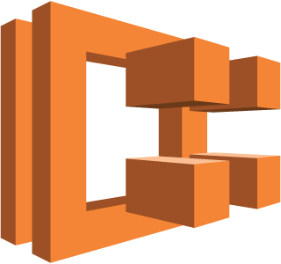




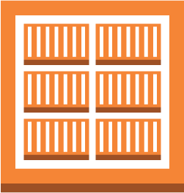




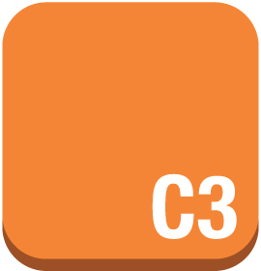
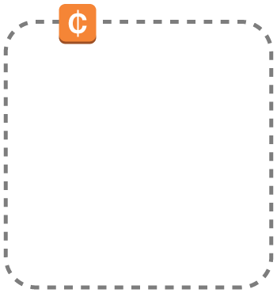





Compute
Compute icons continue on next slide
Amazon EC2
Amazon ECR
Amazon ECS
Amazon Lightsail
AMI
Auto Scaling
DB on instance
Elastic IP address
ECR registry
EC2 compute container 1
instances
instance with CloudWatch
optimized instance
Spot Fleet
EC2 compute container 2
instance
Spot Instance
X1 instance
EC2 compute container 3

Slide 5





















Compute (Continued)
Amazon VPC
AWS Batch
AWS Elastic Beanstalk
AWS
Lambda
Elastic Load Balancing
customer gateway
elastic network adapter
elastic network interface
endpoints
application
Lambda function
Classic Load Balancer
flow logs
Internet gateway
router
VPC NAT gateway
deployment
Application Load Balancer
VPC peering
VPN connection
VPN gateway

Slide 6
Storage

Slide 7

















Storage
Amazon EFS
Amazon Glacier
Amazon S3
AWS Snowball
AWS Storage Gateway
EFS share
archive
bucket
import/ export
cached volume
Amazon EBS
vault
bucket with objects
non-cached volume
snapshot
object
virtual tape library
volume

Slide 8
Database

Slide 9






















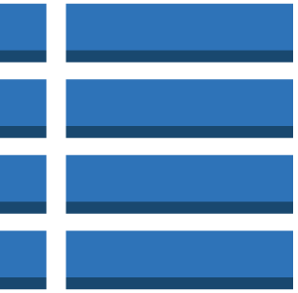





Database
Database icons continue on next slide
Amazon DynamoDB
Amazon ElastiCache
Amazon RDS
Amazon Redshift
attribute
attributes
cache node
MS SQL instance
MS SQL instance alternate
MySQL DB instance
MySQL instance alternate
Oracle DB instance
dense compute node
global secondary index
item
Memcached
Oracle DB instance alternate
PIOP
Postgre SQL instance
RDS DB instance
dense storage node
items
table
Redis
RDS DB instance standby (multi-AZ)
RDS DB instance read replica
SQL master
SQL slave

Slide 10


Database (Continued)
AWS DMS
database migration workflow/job

Slide 11
Migration

Slide 12


Migration
AWS Application Discovery Service
AWS DMS
AWS SMS
AWS Snowball*
database migration workflow/job
import/ export

Slide 13
Networking & Content Delivery

Slide 14






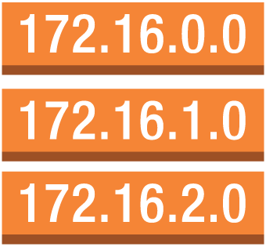

Networking & Content Delivery
Amazon CloudFront
Amazon Route 53
Amazon VPC
AWS Direct Connect
Elastic Load Balancing
download distribution
hosted zone
customer gateway
elastic network adapter
elastic network interface
endpoints
Classic Load Balancer
edge location
route table
flow logs
Internet gateway
router
VPC NAT gateway
Application Load Balancer
streaming distribution
VPC peering
VPN connection
VPN gateway

Slide 15
Developer Tools

Slide 16





Developer Tools
AWS CodeBuild
AWS CodeCommit
AWS CodeDeploy
AWS CodePipeline
AWS X-Ray

Slide 17
Management Tools

Slide 18


















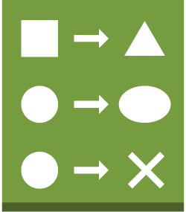


Management Tools
Management Tools icons continue on next slide
Amazon CloudWatch
AWS CloudFormation
AWS CloudTrail
AWS Config
AWS Managed Services
AWS OpsWorks
alarm
event (time-based)
stack
apps
deployments
instances
config rule
template
layers
monitoring
permissions
event (event-based)
change set
resources
stack

Slide 19







Management Tools (Continued)
AWS Service Catalog
AWS Trusted Advisor
checklist
checklist cost
checklist fault tolerance
checklist performance
checklist security

Slide 20
Security, Identity & Compliance

Slide 21







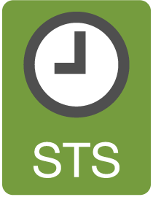










Security, Identity & Compliance
Security, Identity & Compliance icons continue on next slide
Amazon Inspector
AWS Artifact
AWS Certificate Manager
AWS CloudHSM
AWS Directory Service
IAM
agent
certificate manager
add-on
AWS STS
AWS STS (alternate)
data encryption key
encrypted data
long-term security credential
MFA token
permissions
role
temporary security credential

Slide 22





Security, Identity & Compliance (Compliance)
AWS KMS
AWS Organizations
AWS Shield
AWS WAF
filtering rule

Slide 23
Analytics

Slide 24











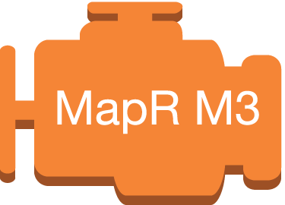


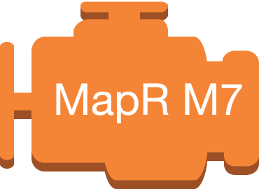
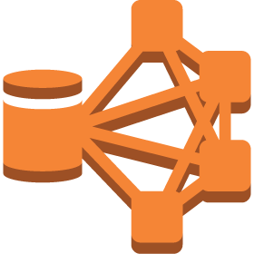

Analytics
Analytics icons continue on next slide
Amazon Athena
Amazon CloudSearch
Amazon EMR
Amazon ES
Amazon Kinesis
Amazon QuickSight
Amazon Redshift*
search documents
cluster
EMR engine
Amazon Kinesis Analytics
Amazon Kinesis– enabled app
dense compute node
EMR engine MapR M3
EMR engine MapR M5
Amazon Kinesis Firehose
dense storage node
EMR engine MapR M7
HDFS cluster
Amazon Kinesis Streams

Slide 25

Analytics (Continued)
AWS Data Pipeline

Slide 26
Artificial Intelligence

Slide 27




Artificial Intelligence
Amazon Lex
Amazon Machine Learning
Amazon Polly
Amazon Rekognition

Slide 28
Mobile Services

Slide 29






Mobile Services
Amazon API Gateway*
Amazon Cognito
Amazon Mobile Analytics
Amazon Pinpoint
AWS Device Farm
AWS Mobile Hub

Slide 30
Application Services

Slide 31






Application Services
Amazon API Gateway
Amazon AppStream
Amazon Elastic Transcoder
Amazon
SWF
AWS Step Functions
decider
worker

Slide 32
Messaging

Slide 33









Messaging
Amazon Pinpoint*
Amazon
SES
Amazon SNS
Amazon SQS
email
email notification
message
HTTP notification
queue
topic

Slide 34
Business Productivity

Slide 35


Business Productivity
Amazon WorkDocs
Amazon WorkMail

Slide 36
Desktop & App Streaming

Slide 37


Desktop & App Streaming
Amazon AppStream 2.0*
Amazon WorkSpaces

Slide 38
Internet of Things (IoT)

Slide 39


















Internet of Things (IoT)
Internet of Things (IoT) icons continue on next slide
AWS IoT
IoT thing bank
IoT thing bicycle
IoT thing camera
IoT thing car
IoT thing cart
IoT thing coffee pot
IoT thing door lock
IoT thing factory
IoT thing generic
IoT thing house
IoT thing lightbulb
IoT thing medical emergency
IoT thing police emergency
IoT thing thermostat
IoT thing travel
IoT thing utility
IoT thing windfarm

Slide 40

























Internet of Things (IoT) (Continued)
AWS IoT (Continued)
AWS Greengrass
IoT action
IoT actuator
IoT certificate
IoT desired state
IoT hardware board
IoT HTTP protocol
IoT HTTP/2 protocol
IoT MQTT protocol
IoT policy
IoT reported state
IoT rule
IoT sensor
IoT servo
IoT
shadow
IoT simulator
IoT topic
Alexa skill
Alexa smart home skill
Alexa voice service
Alexa enabled device
Echo
Fire TV
Fire TV stick
Lambda function

Slide 41
Game Development

Slide 42

Game Development
Amazon GameLift

Slide 43



















General
AWS cloud
AWS Management Console
forums
virtual private cloud
client
Internet
Internet alt1
Internet alt2
corporate data center
disk
generic database
office building
mobile client
multimedia
SAML token
SSL padlock
tape storage
traditional server
user
users
AWS Simple Icons: Non-Service Specific

Slide 44





On-Demand Workforce
Amazon Mechanical Turk
Amazon
Mechanical Turk
assignment/
task
human intelligence tasks (HIT)
requester
workers
Mechanical Turk vs. Amazon Mechanical Turk
Do not use simple "Mechanical Turk" to refer to Amazon Mechanical Turk. Use Amazon Mechanical Turk to describe the entire system, Amazon Mechanical Turk website for the worker website, and Amazon Mechanical Turk web service to describe the product.
AWS Simple Icons: On-Demand Workforce

Slide 45














SDKs
Android
iOS
Java
JavaScript
.NET
Node.js
PHP
Python (boto)
Ruby
Xamarin
AWS CLI
AWS Toolkit for Eclipse
AWS Toolkit for Visual Studio
AWS Tools for Windows PowerShell
AWS Simple Icons: SDKs

Slide 46
Groups
Auto Scaling group
Availability Zone
region
security group
Elastic Beanstalk container
EC2 instance contents
VPC subnet
server contents
AWS Simple Icons: Groups

Slide 47
Groups (Continued)
virtual private cloud
AWS cloud
corporate data center
AWS Simple Icons: Groups

Slide 48

Example: 2-Tier Scalable Web Application Architecture in 1 Zone
www.example.com
media.example.com
Amazon Route 53
CloudFront
distribution
web app
server
root volume
logs
Elastic Load Balancing
EC2 instance
security group
data volume
Amazon EBS snapshot
Amazon S3 bucket
Auto Scaling group
security group
Availability Zone #1
AWS Simple Icons: Example

